Slide 1
Team SHMAT
Suraj, Hubery, Marko, Adam, Tiago

Slide 2
Team Introduction
Adam
Shader wizard, backup programmer
Suraj
3D modeller
Tiago
UI, music, sound FX
Hubery
Programmer
Marko
TBD

Slide 3
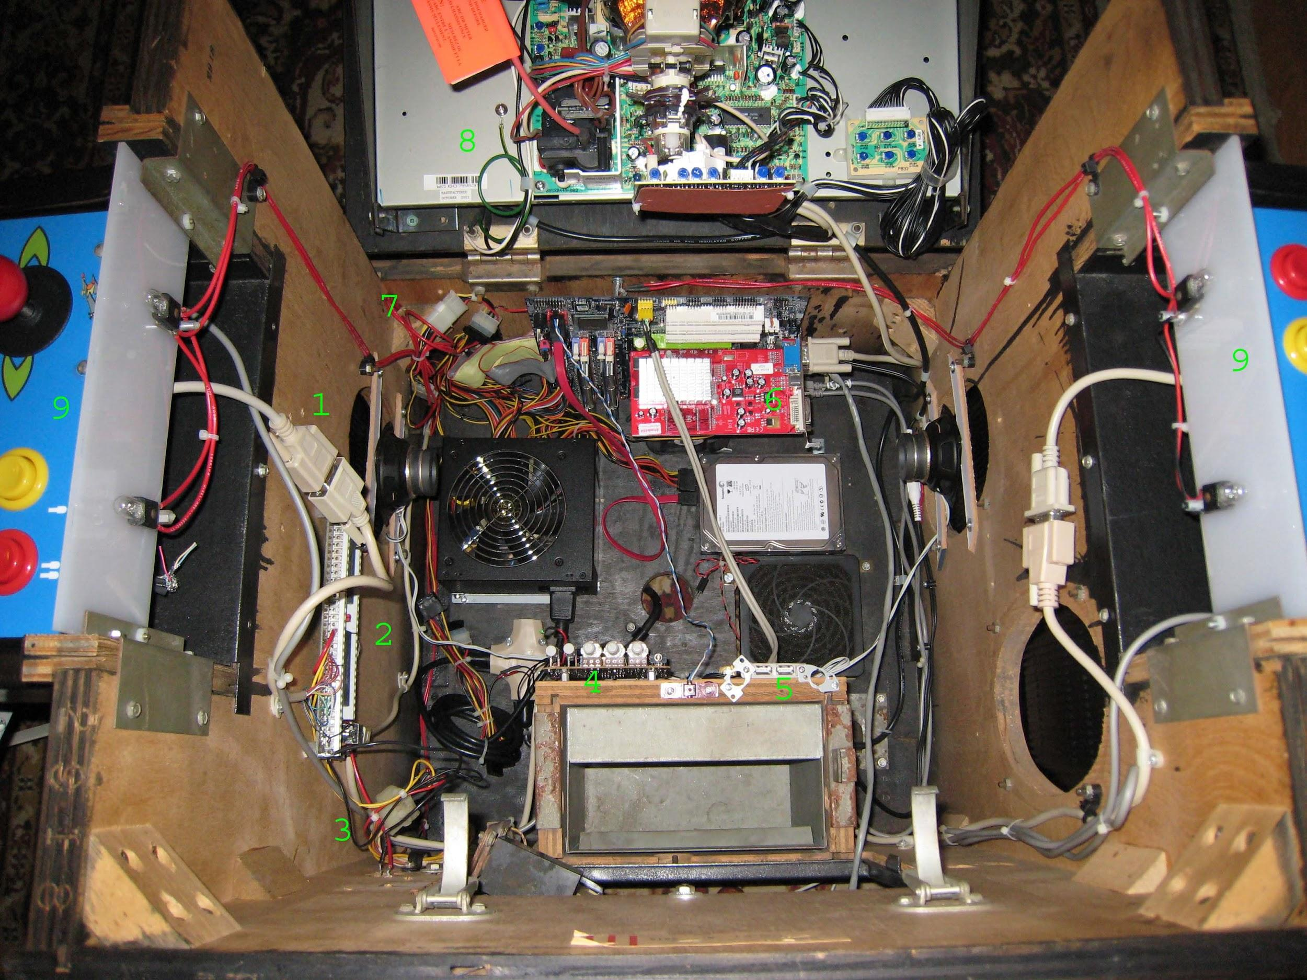
Characteristics of good arcade games
Fast-paced
Short play sessions
Rapidly increasing difficulty
Good learning curve
Easy to get down the controls
Room for growth in skills
Replay values
Dynamic gameplay
Competitive
Entertaining to spectate

Slide 4
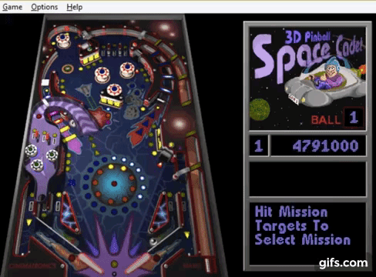
Key References
Pinball
Flippers for defending the goal and redirecting the ball up the playfield.
Bouncing ball

Slide 5
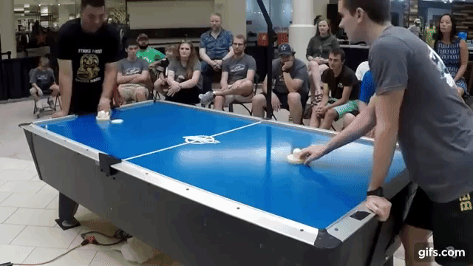
Key References
Air Hockey
The player controls a striker who hits the "ball" and ricochets it
Velocity across the table

Slide 6
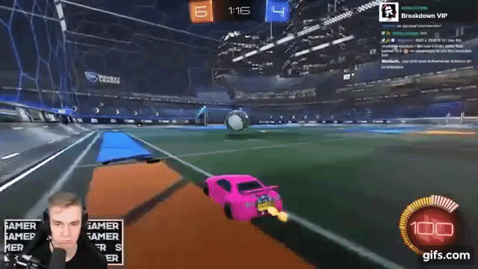
Key References
Rocket League
players dispute the ball only with collision and physics
Player characters fighting over a ball to shoot into goals

Slide 7
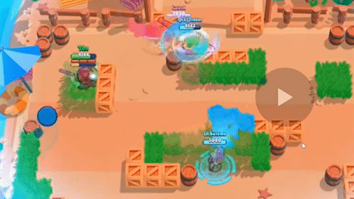
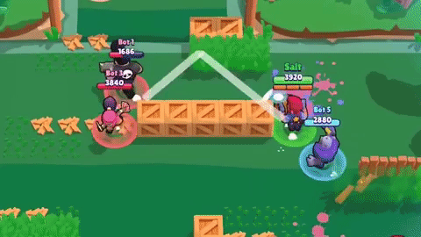
Key References
Brawl Stars
Brawlball gamemode
Player characters fighting over a ball to shoot into goals

Slide 8
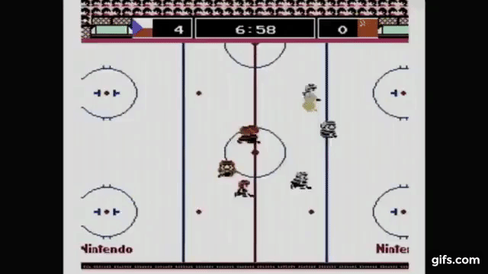
Key References
Ice Hockey (NES)
Multiple player characters spread across the field controlled simultaneously
Player characters fighting over a ball to shoot into goals

Slide 9
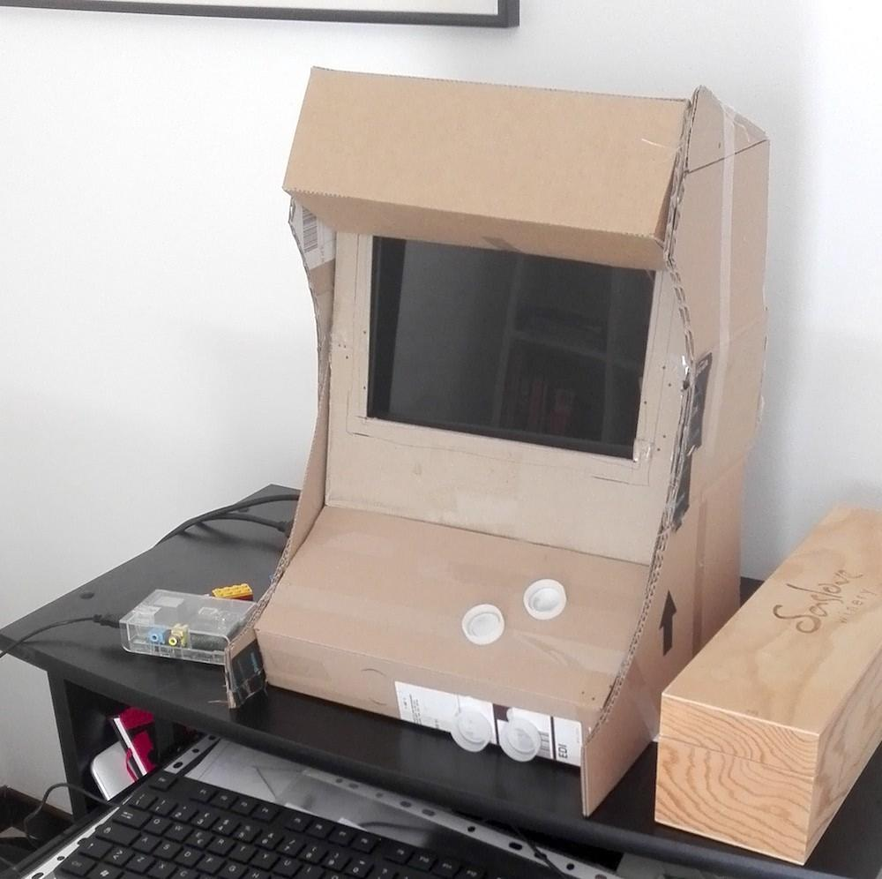
Next Steps
Explore our primary idea
Prototype mechanics
Aesthetic style
Definition
References
Get sleep maybe
Rapid prototypes

